Slide 1
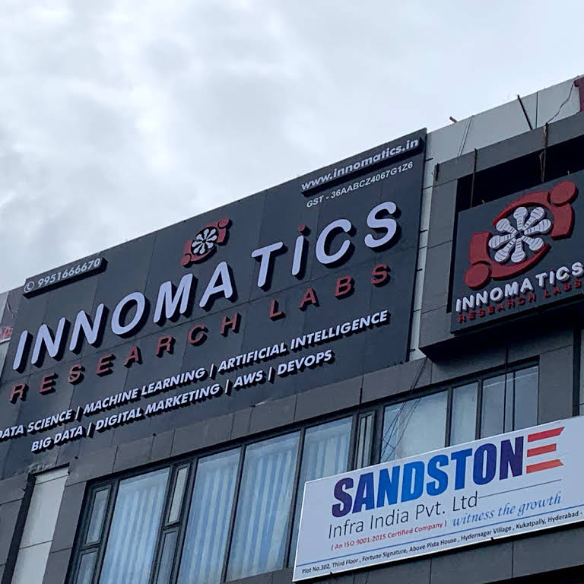
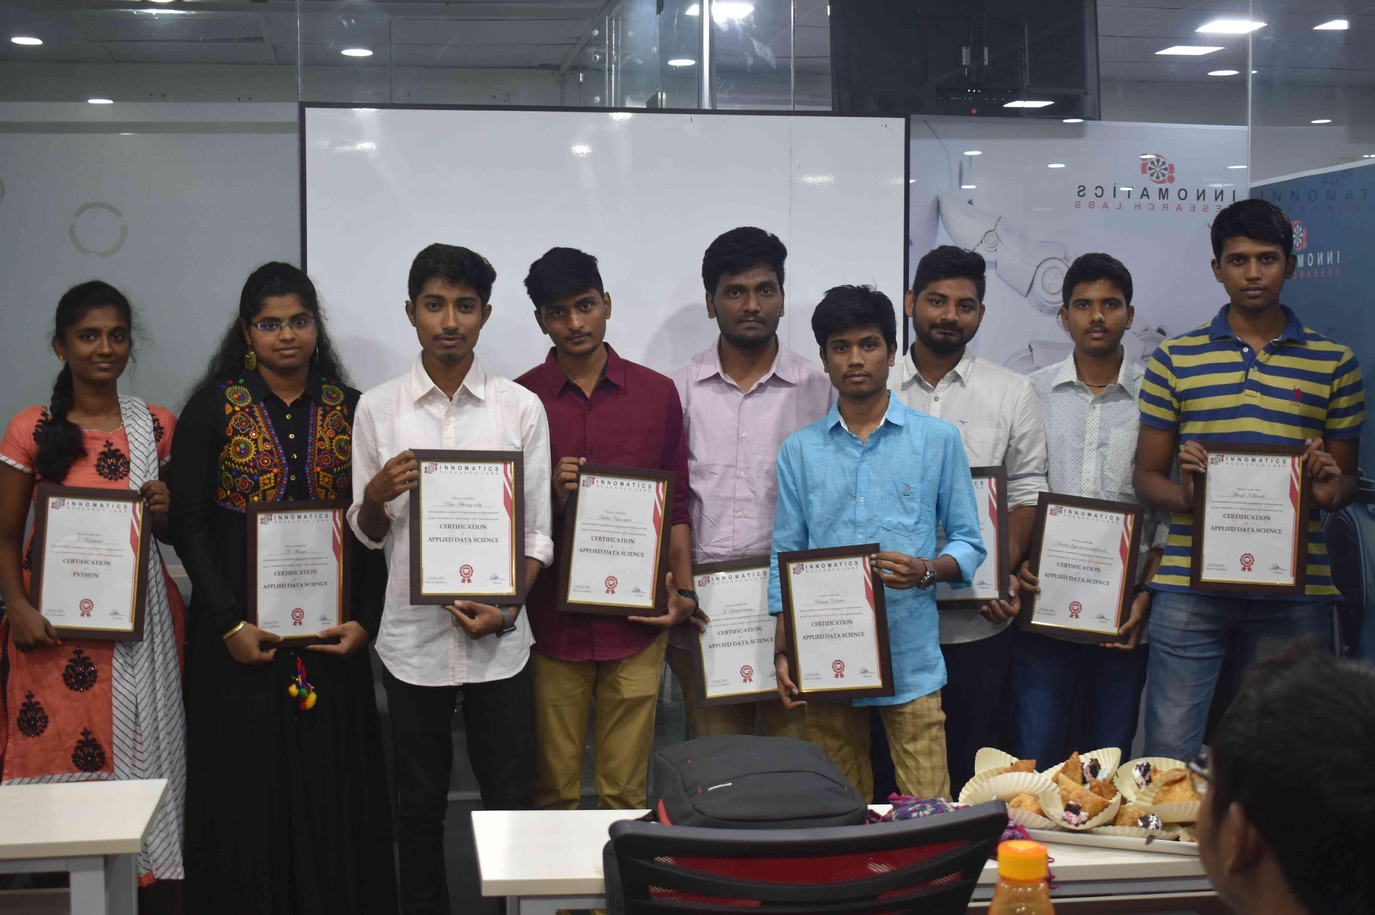
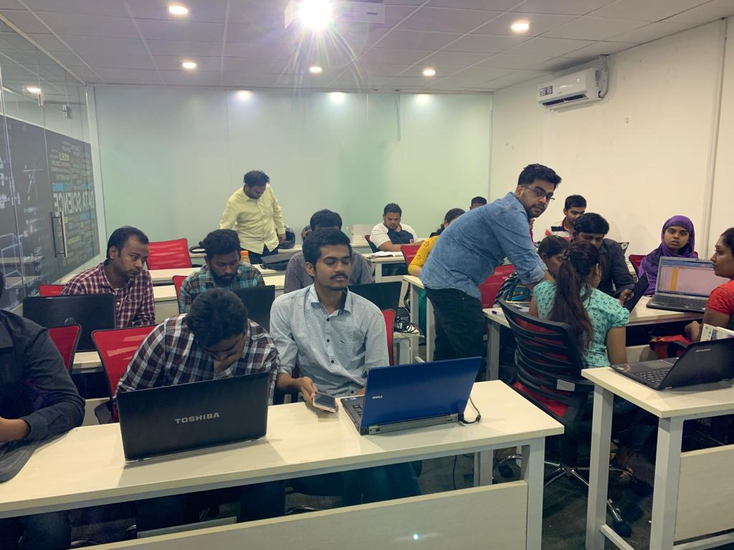

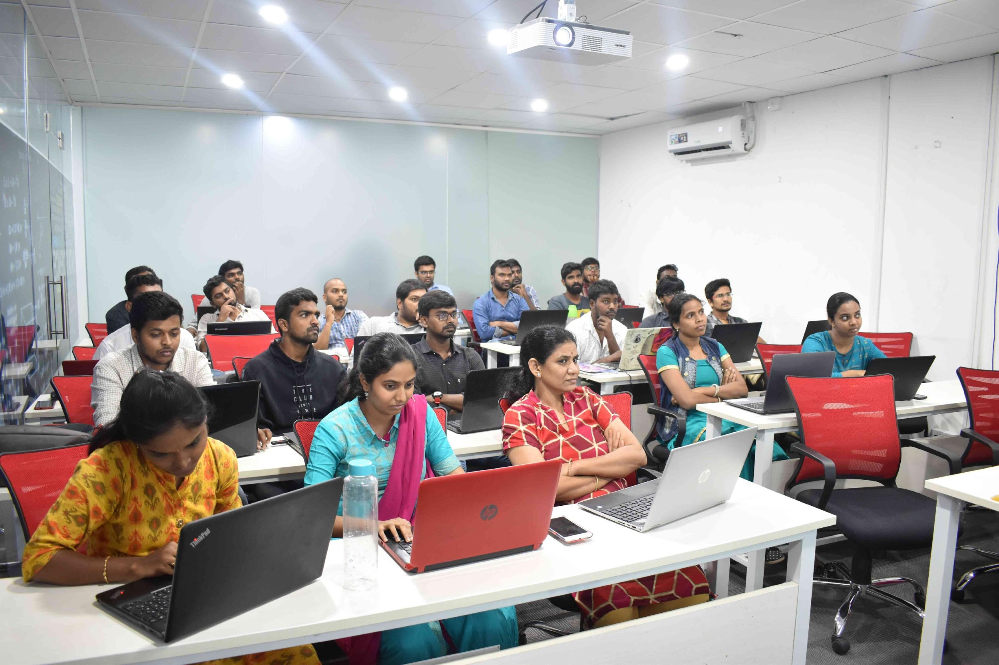
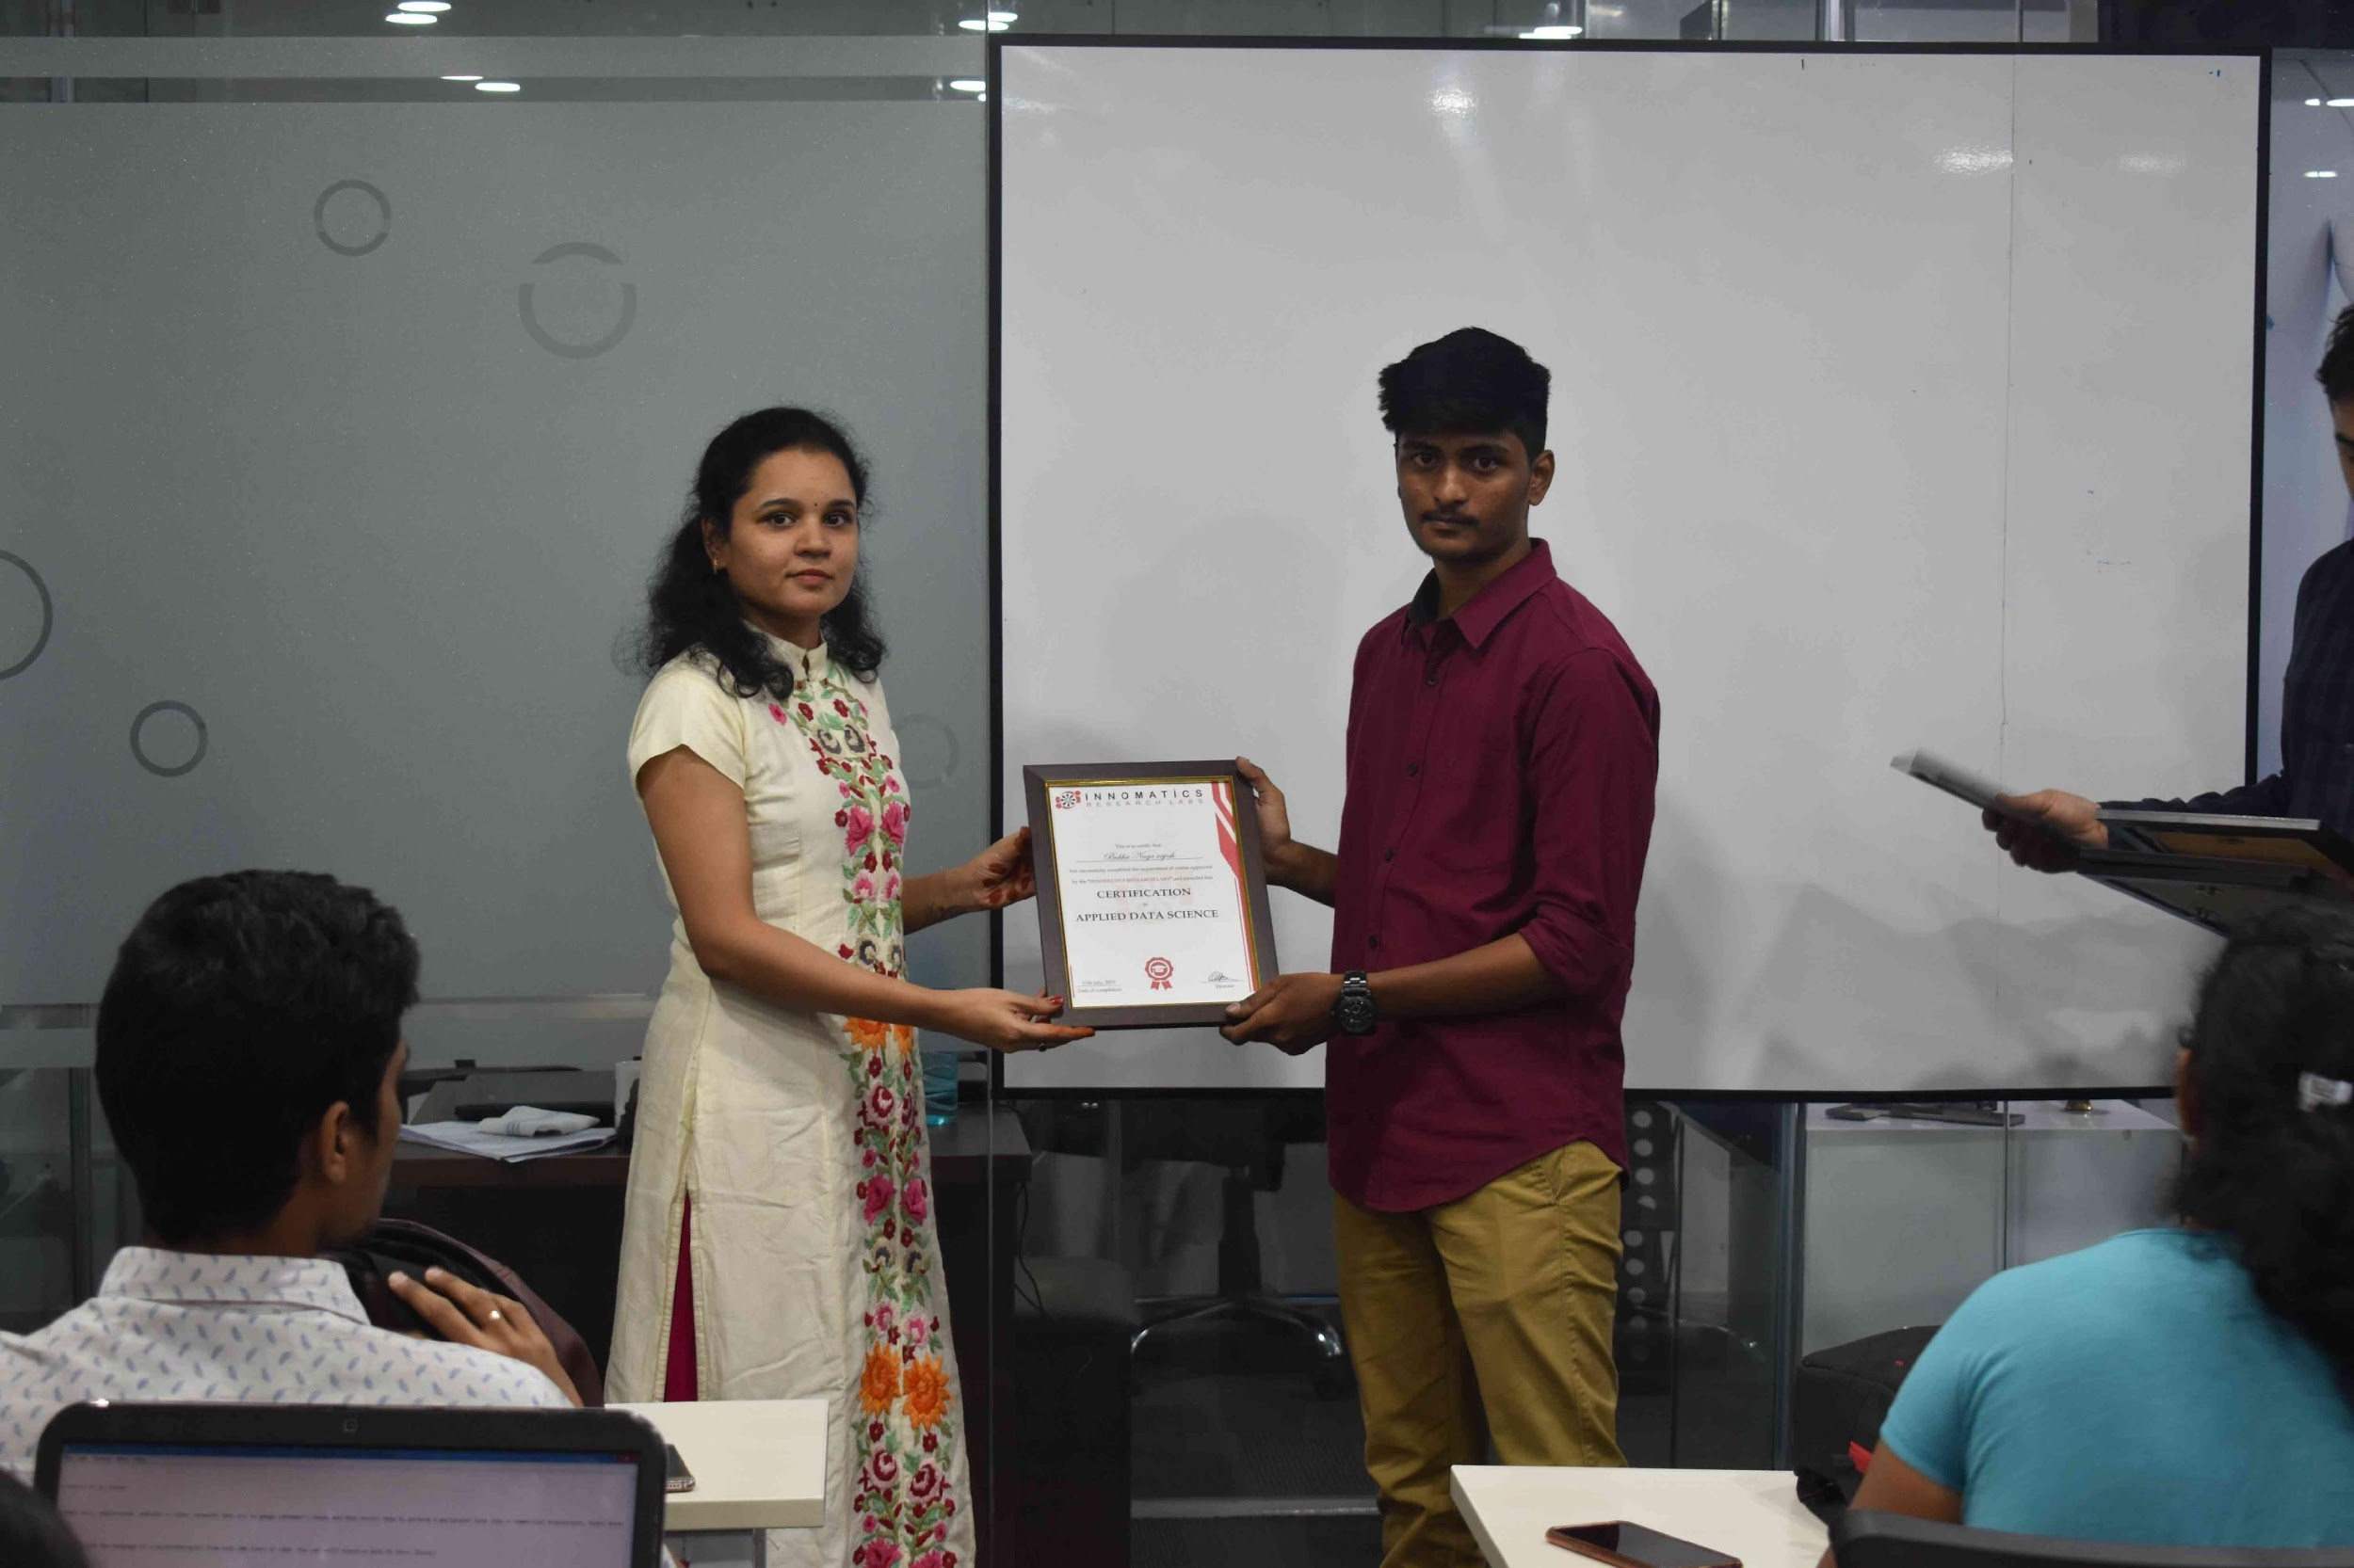
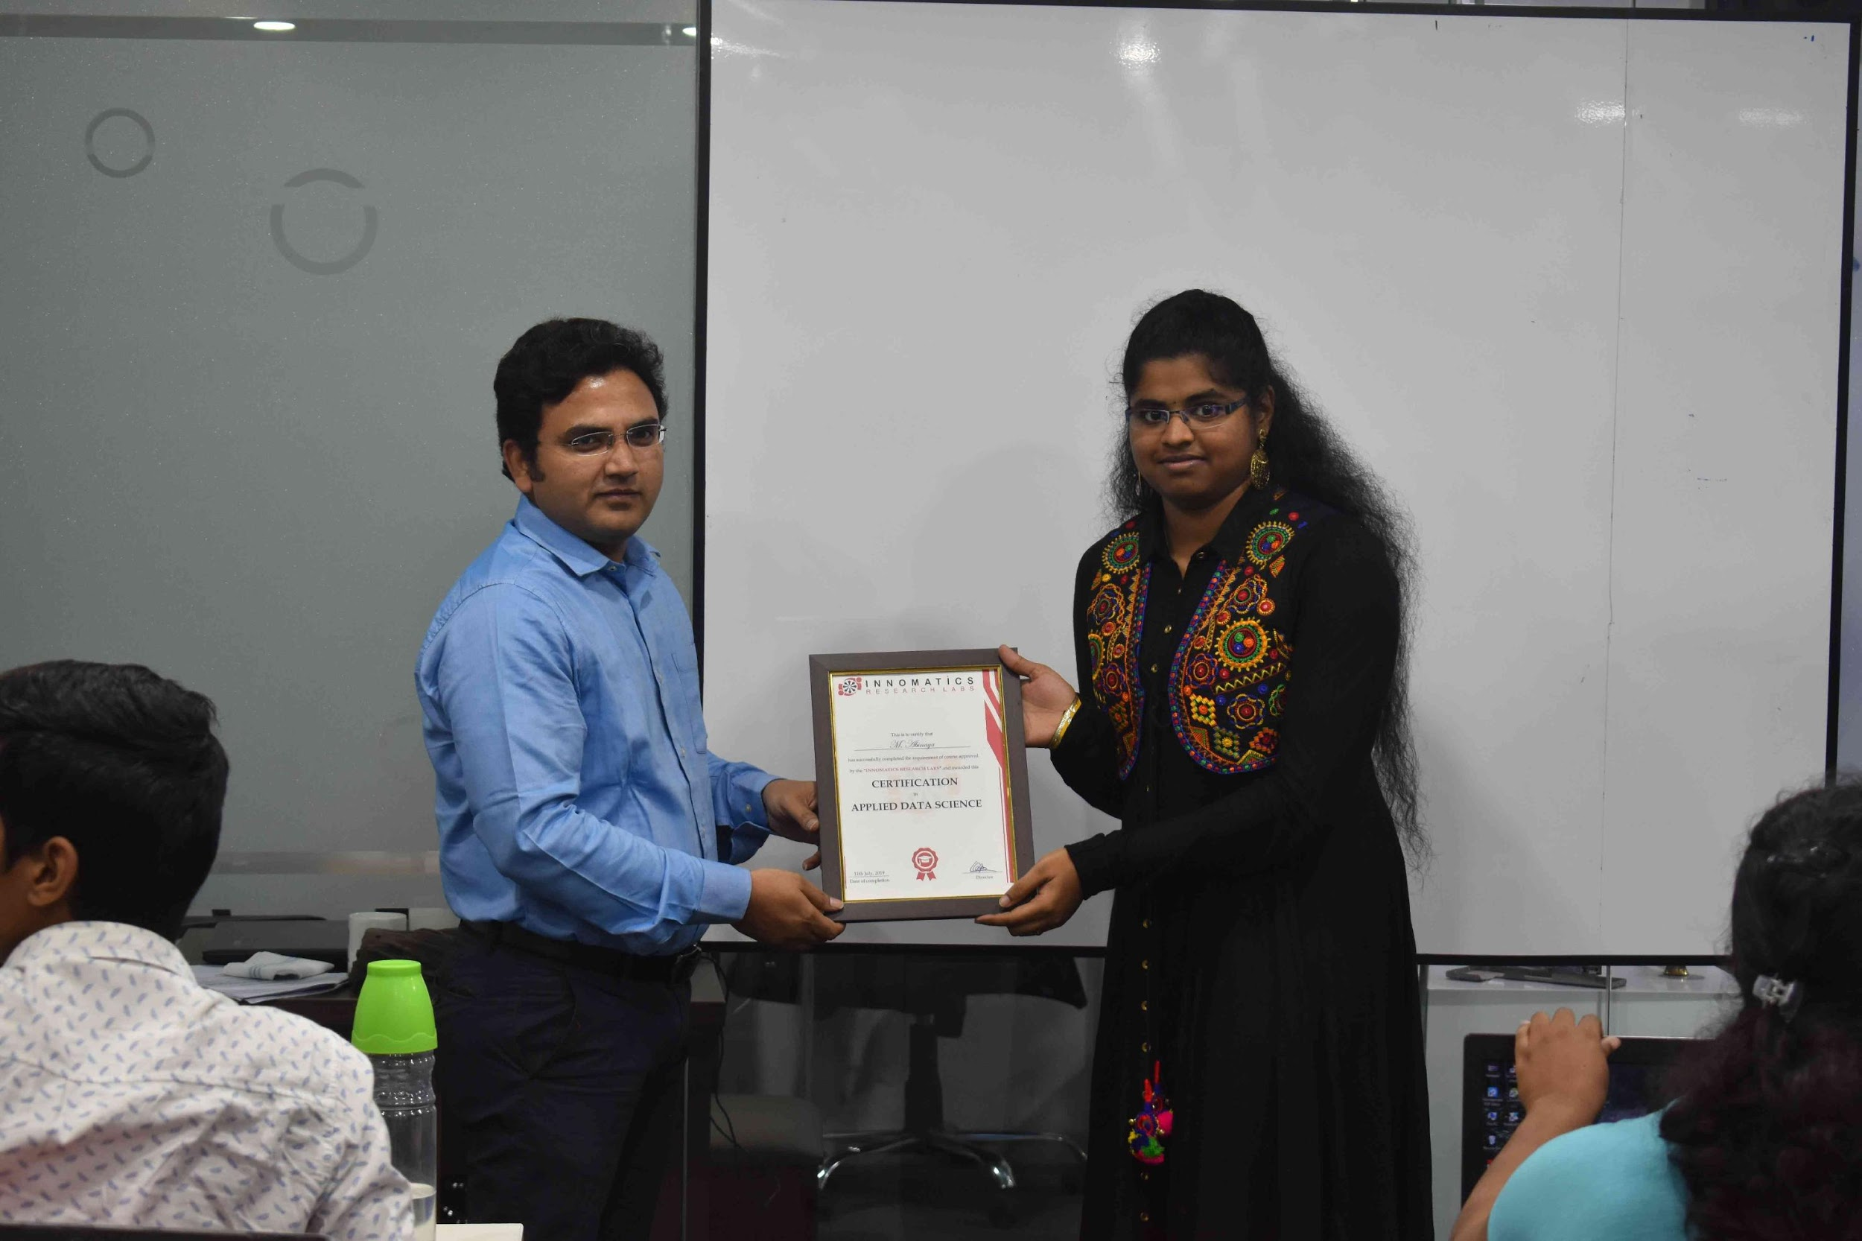

Slide 2
A Personalized Music Recommendation System [Results Description]
Group No. 5
Mentor : Akhila Ma’am
Team Members :
Aravind Patel [IN30005]
Mohit kumar [IN30163]
Dileep Chowdary [IN30212]
Ajay sai kiran [IN30094]
Nitin Borse [IN30063]

Slide 3
About us
Background ? (B-tech or M-tech)
Aravind Patel – B.Tech.
Mohit Kumar – B.Tech.
Dileep Chowdary – B.Tech.
Ajay sai kiran – M.Tech
Nitin Borse -B.Tech
Why you want to learn Data Science
Data Science is the powerhouse of industries nowadays that will helps industries to improve their performance ,business growth. So, It is in trending and an interesting field that’s why we want to learn Data Science
Any work experience
Aravind Patel –Fresher
Mohit Kumar – Fresher
Dileep Chowdary – Fresher
Ajay sai kiran – 4 years of exp as Assistant Professor
Nitin Borse –Fresher
What do you like about Innomatics Research labs
Innomatics Research Labs continuously force you to do better and improve yourself. It finds out the best in you. Flexible Training helps us make sessions more interactive. Supportive mentors are always here for us .
We would like to thank Innomatics Research Labs for providing us this awesome opportunity and all the mentors for their help .

Slide 4
Table of Contents :
Problem Statement
Recommender System
Data Preparation
Popularity Based Recommendation System
Content Based Recommendation System
Collaborative Filtering Based Recommendation System
Future Scope

Slide 5
Problem Statement :
Since most of the music albums are sold on digital platform, selecting a particular song from a large database will be a difficult task for an user.
When it comes to providers ,cold start is a big issue as new user does not share any historical data with them.

Slide 6
Recommender System
A recommendation engine is a system that suggests products, services, information to users based on analysis of data.
The recommendation can derive from a variety of factors such as the history of the user and the behavior of similar users
With millions of customers and data on their online behavior, e-commerce companies are best suited to generate accurate recommendations
Increased sales/conversion
Increased user satisfaction

Slide 7
Datasets :
kaggle_songs.txt : It contains details of the songs like song_id.
2. kaggle_users.txt: It contains data related to user like user_id.
3. unique_tracks.txt: This dataset contains columns like track_id, song_id, singer_name, Title.
4. taste_profile_song_to_tracks.txt: It contains columns like track_id,
song_id.
5. kaggle_visible_evaluation_triplets.txt: It contains details of the songs like user_id, song_id, song_count.

Slide 8
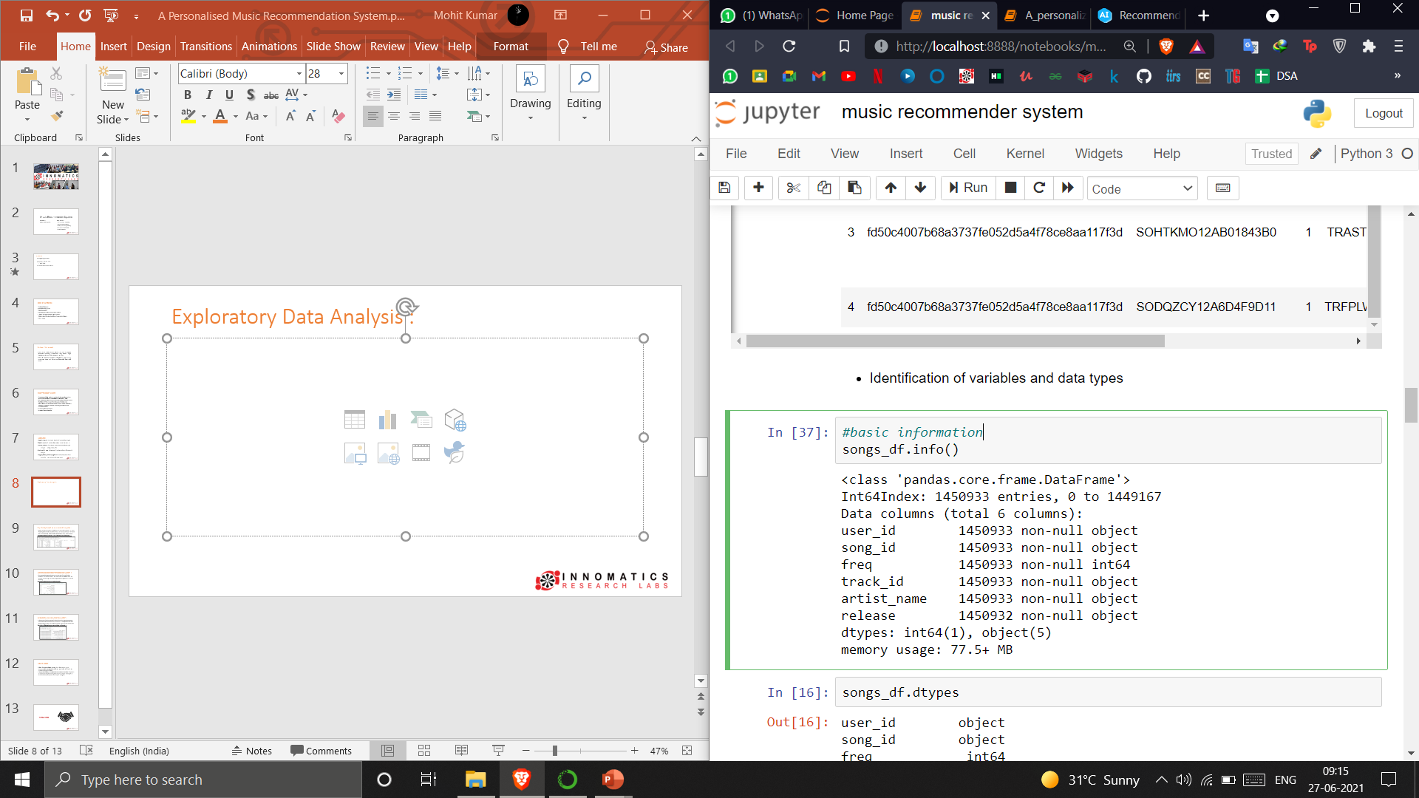
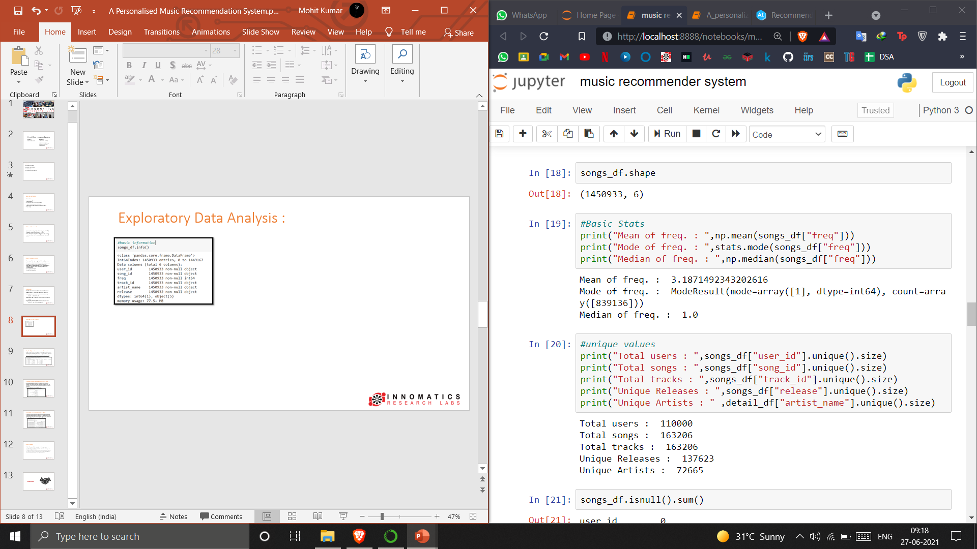
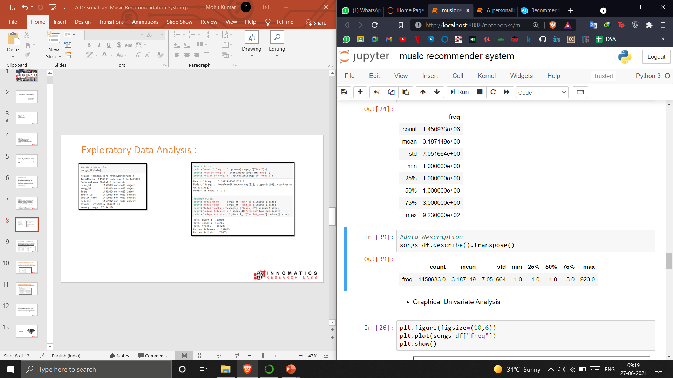
Exploratory Data Analysis :

Slide 9
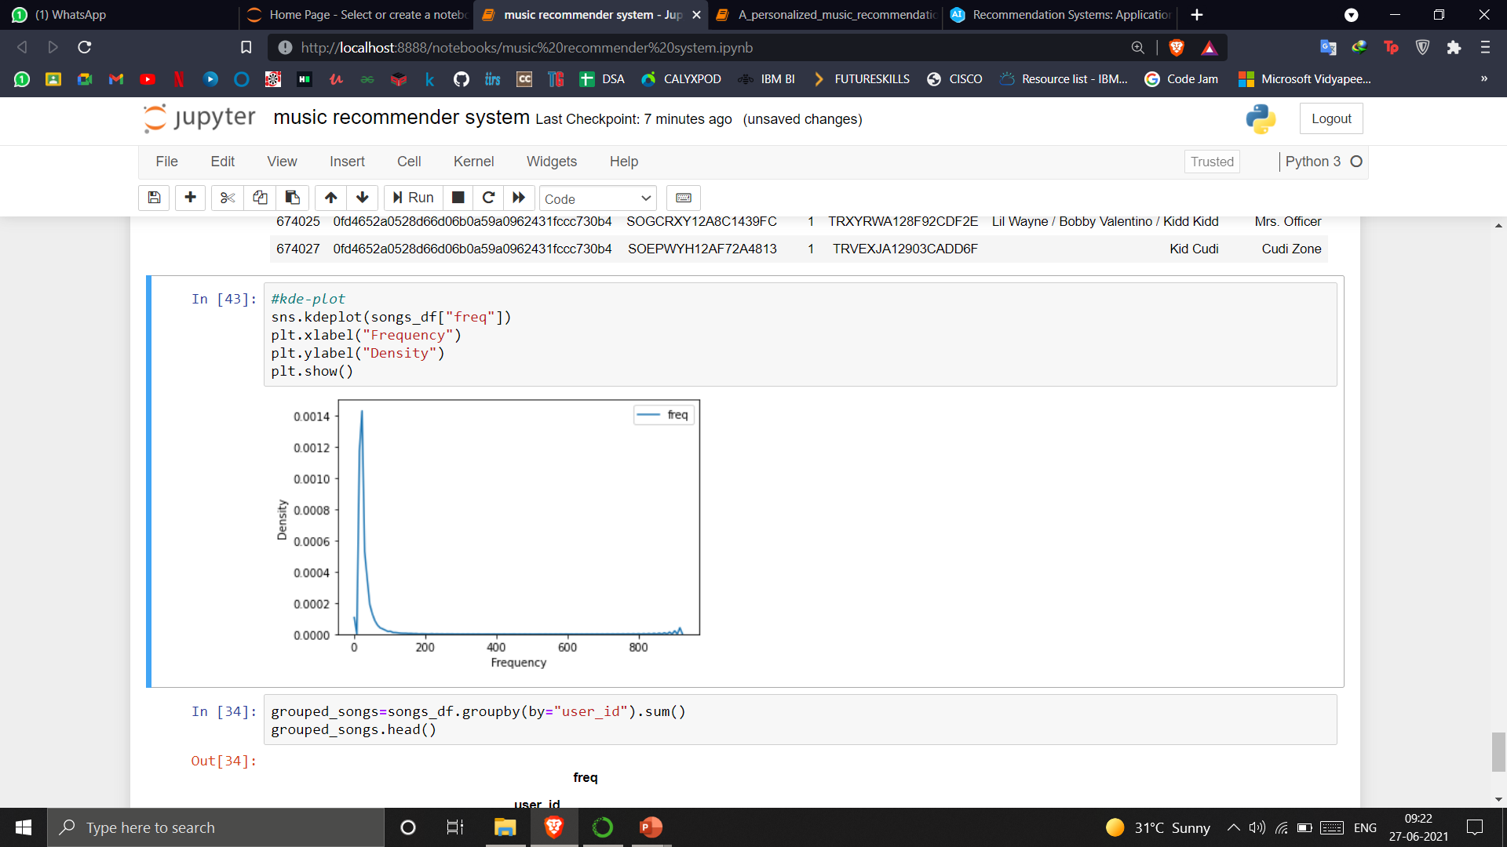
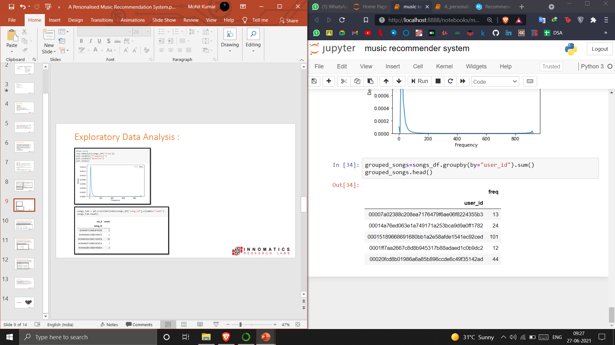
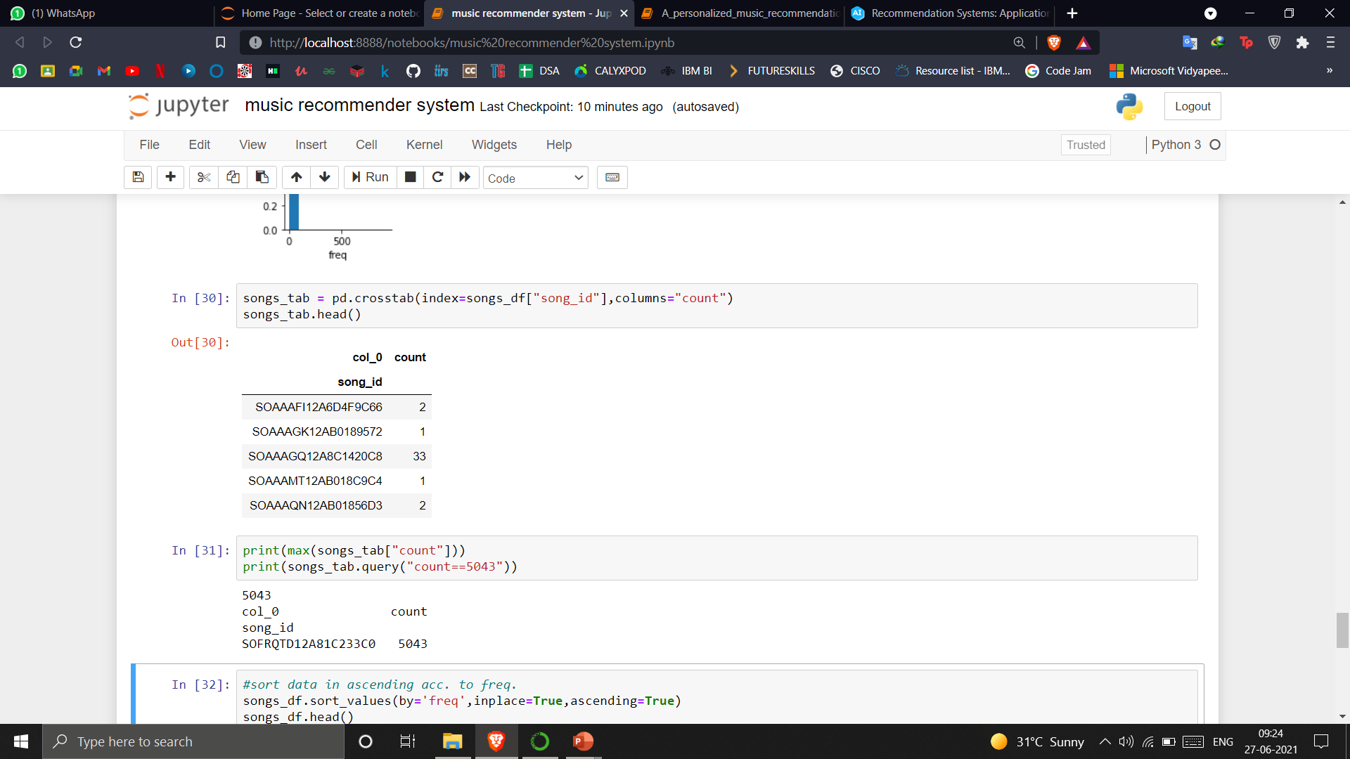
Exploratory Data Analysis :

Slide 10
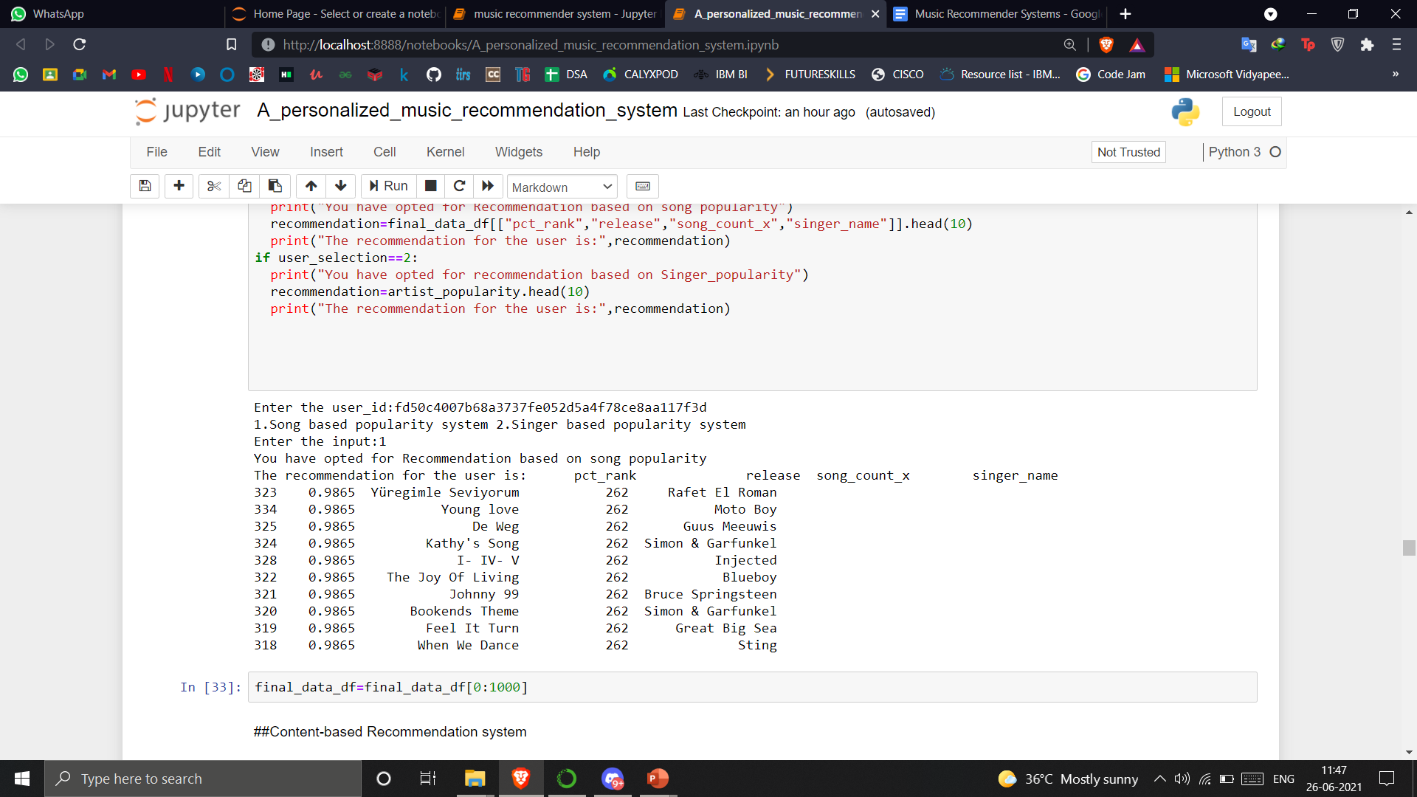
Popularity based recommendation system :
Works on the principle of popularity and or anything which is in trend. These systems check about the product or movie which are in trend or are most popular among the users and directly recommend those.
Recommendation Depending upon Artist and Song Popularity :

Slide 11
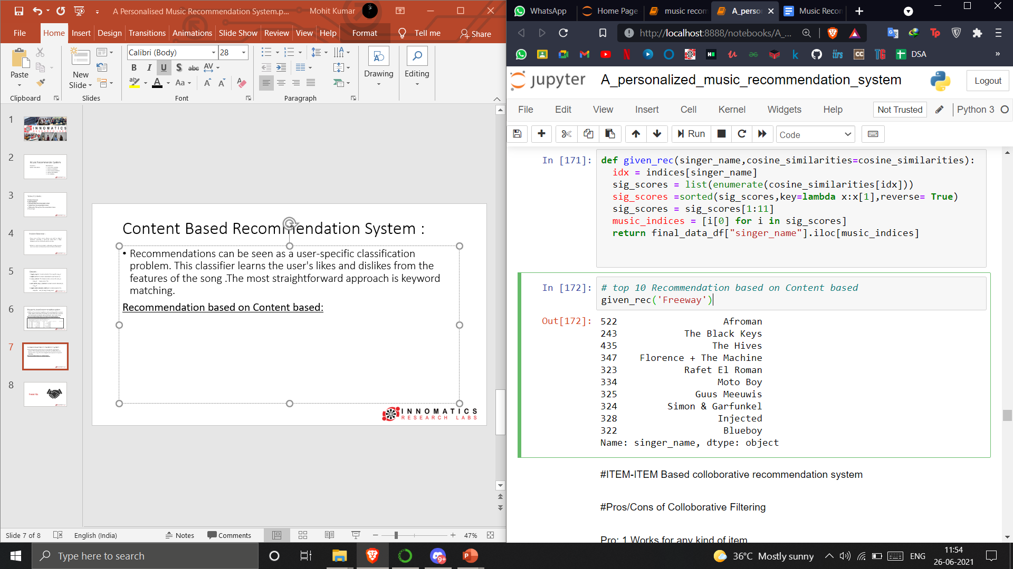
Content Based Recommendation System :
Recommendations can be seen as a user-specific classification problem. This classifier learns the user's likes and dislikes from the features of the song .The most straightforward approach is keyword matching.
Recommendation based on Content based:

Slide 12
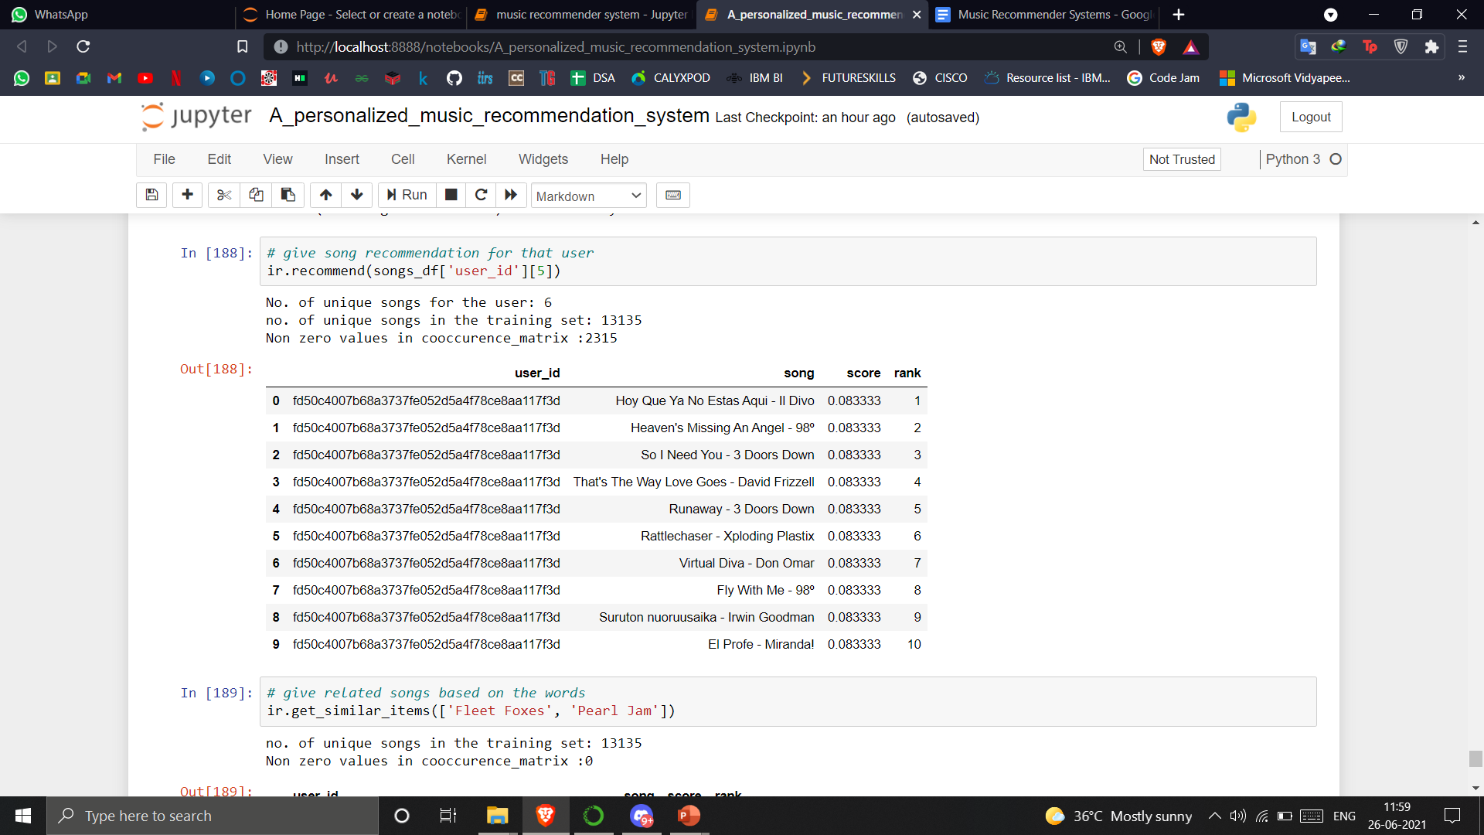
Collaborative recommendation system :
Collaborative filtering method is based on collecting and analyzing information based on behaviors, activities, or user preferences and predicting what they will like based on the similarity with other users.
Item-Item collaborative recommendation to the user :

Slide 13
Future Scope :
Hybrid Recommendation system :
It combine two or more recommendation strategies in different ways to benefit from their complementary advantages.
Advanced or “Non-Traditional Approches:
Deep learning
Social recommendations
Learning to Rank
Using suprise library to implement recommender system :
Surprise is an open-source Python library that makes it easy for developers to build recommender systems with explicit rating data.

Slide 14

THANK YOU

